Slide 1
ByteForge
(Senior Design)
By Dylan Bok

Slide 2
Short Abstract (Goal)
ByteForge
This project explores the full development cycle of a game—from initial concept to potential publication, time permitting—along with all the technical and creative requirements needed to reach that goal.

Slide 3
Contact Info
Developer Lead: Dylan
-bokdl@mail.uc.edu
Advisor: Prof. Yu Zhao
-fred.annexstein@uc.edu
ByteForge

Slide 4
Abstract
ByteForge
This project explores the complete development cycle of a video game, from initial concept through potential publication, time permitting. It covers both the technical and creative requirements involved in building a game, including prototyping, playtesting, debugging, and deployment. A core focus is the use of rapid feedback and iterative design to refine gameplay and user experience.
The project also serves as a demonstration of sustained effort and adaptability—highlighting the ability to work on a long-term, evolving challenge while continuously learning new tools and techniques. As unfamiliar frameworks and design principles are encountered, they are integrated into the workflow, reflecting a commitment to growth and resilience.
By emphasizing feedback loops, usability testing, and agile design, the project illustrates how responsiveness and iteration contribute to a more polished final product. Ultimately, it showcases not only the complexity of game development but also the developer’s capacity for persistence, creativity, and self-directed learning over an extended period.

Slide 5
User Story:
ByteForge
This diversity in player motivation highlights the importance of designing games that accommodate both narrative-driven engagement and casual enjoyment. It also underscores the subjective nature of game interpretation, where each player may derive unique value from the same experience.
As a gamer, I want to launch and play a video game, so that I can experience enjoyment, relaxation, and entertainment during my leisure time.

Slide 6
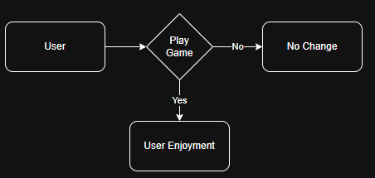
Design Diagrams (D0)
ByteForge
D0: If the user plays the game they will then derive a level of enjoyment.

Slide 7
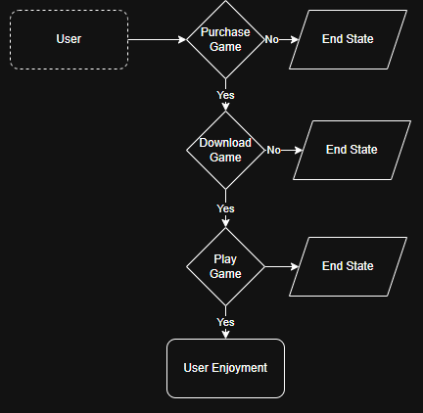
Design Diagrams (D1)
ByteForge
D1: If the user purchases, downloads, and plays the game, they will ultimately derive a sense of joy from the experience. While end states like emotional satisfaction are important to acknowledge, they fall outside the scope of this diagram focus.

Slide 8
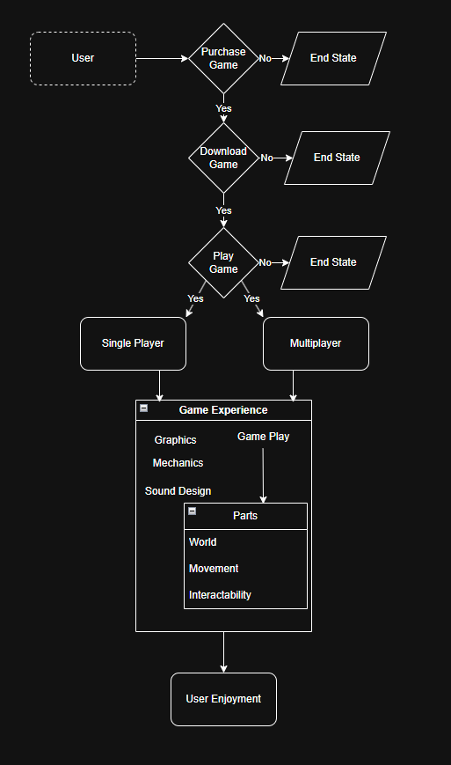
Design Diagrams (D2)
ByteForge
D2: If the user purchases, downloads, and plays the game, they will ultimately derive a sense of joy from the experience. Upon launching the game, the user can choose between a multiplayer or single-player mode, depending on their preferred style of engagement. The overall game experience is shaped by several core components, including graphics, mechanics, sound design, and gameplay. Gameplay itself is composed of additional elements that define the user's interaction with the game world—such as environment design, character movement, and the level of control or intractability available to the player.

Slide 9
Project Constraints
ByteForge

Slide 10
ByteForge
Every project, regardless of scope or ambition, is shaped by its constraints. My senior design project is no exception. As I move from concept to execution, I’ve identified several key challenges—professional, legal, and security-related—that will influence both the development process and the final product. This essay outlines those concerns and reflects on how they may shape the trajectory of my work.
One of the most immediate challenges involves professional expectations, particularly in the areas of presentation, adherence to standards, and broader development requirements. Presentation is a critical component of any software product, especially one intended for public consumption. A visually engaging and intuitive interface can elevate a project’s impact, but this is an area where I lack experience. My limited background in visual design and modeling may result in longer development cycles or underwhelming aesthetics. I recognize that bridging this gap will require additional learning and iteration.
Standards pose another challenge. The compressed timeline of a senior design project means that certain development phases—such as testing, documentation, and refinement—must be accelerated. This can lead to compromises in quality, especially when compared to the rigorous benchmarks expected in professional software and game development. Additionally, I hold myself to a high personal standard, often delaying progress until each component meets my expectations. While this mindset promotes quality, it can conflict with the need for timely delivery. Balancing perfectionism with practicality will be essential.
Professional requirements also extend beyond the technical realm. If the project evolves into a publishable product, I’ll need to consider legal protections such as forming an LLC or similar entity to safeguard intellectual property. Furthermore, if the game is released publicly, I must ensure that the source code is protected and that distribution channels are secure. These considerations introduce a layer of complexity that goes beyond typical academic projects.
Legal compliance is a fundamental aspect of any product that interacts with users or enters the public domain. Whether it involves licensing, copyright, data protection, or business registration, there are rules and regulations that must be followed. Understanding these frameworks and ensuring that my project adheres to them will require research and diligence. This legal learning curve is an important part of transitioning from student developer to professional creator.
Security is another critical concern. Any software that users download or interact with must be designed with safety in mind. It’s essential to ensure that my application does not introduce vulnerabilities—either to my own systems or to the user’s device. This includes protecting against malicious code, securing user data, and verifying the integrity of third-party libraries and dependencies. Building with security as a foundational principle will help ensure that the product is both trustworthy and resilient.
In conclusion, while these constraints present real challenges, they also offer valuable opportunities for growth. My senior design project is more than a technical exercise—it’s a chance to engage with the full lifecycle of software development, from ideation and design to legal compliance and professional presentation. By confronting these issues head-on, I hope to not only deliver a successful project but also deepen my understanding of what it means to build software in the real world.

Slide 11
Project Phases
ByteForge

Slide 12
Phases
ByteForge
01.
Foundation & Planning (October)
02.
Concept & Design (November)
03.
Asset Creation (December–January)
04.
Single-Player Development & Testing (January–May)
06.
Finalization & Documentation (April-May)

Slide 13
Stretch Phase
05. Multiplayer Development & Testing
07. Publication
ByteForge

Slide 14
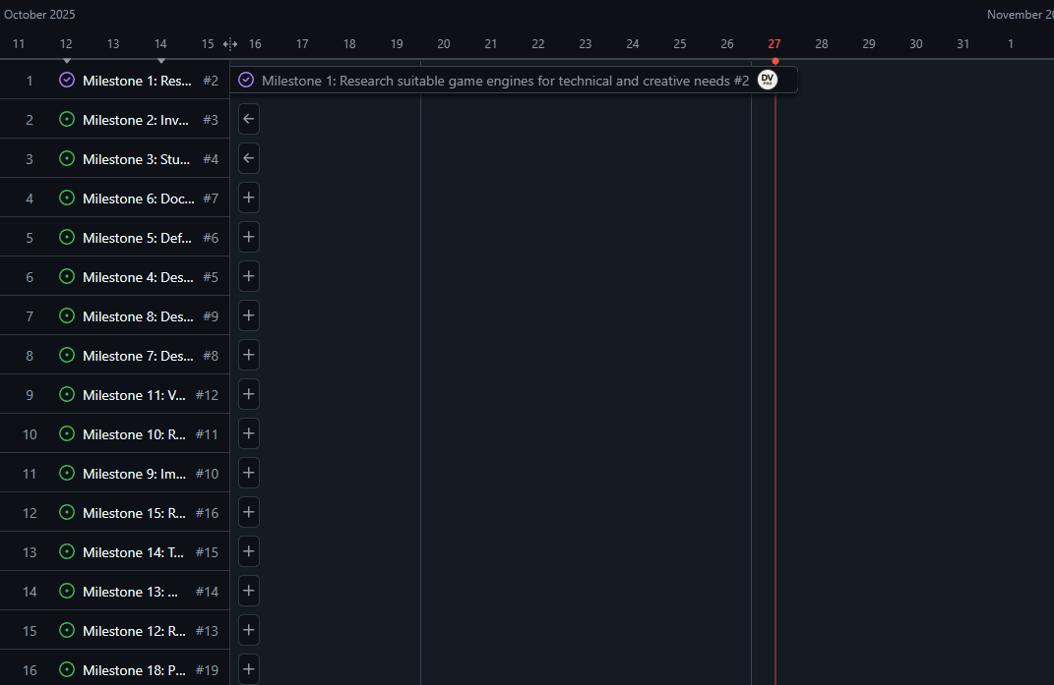
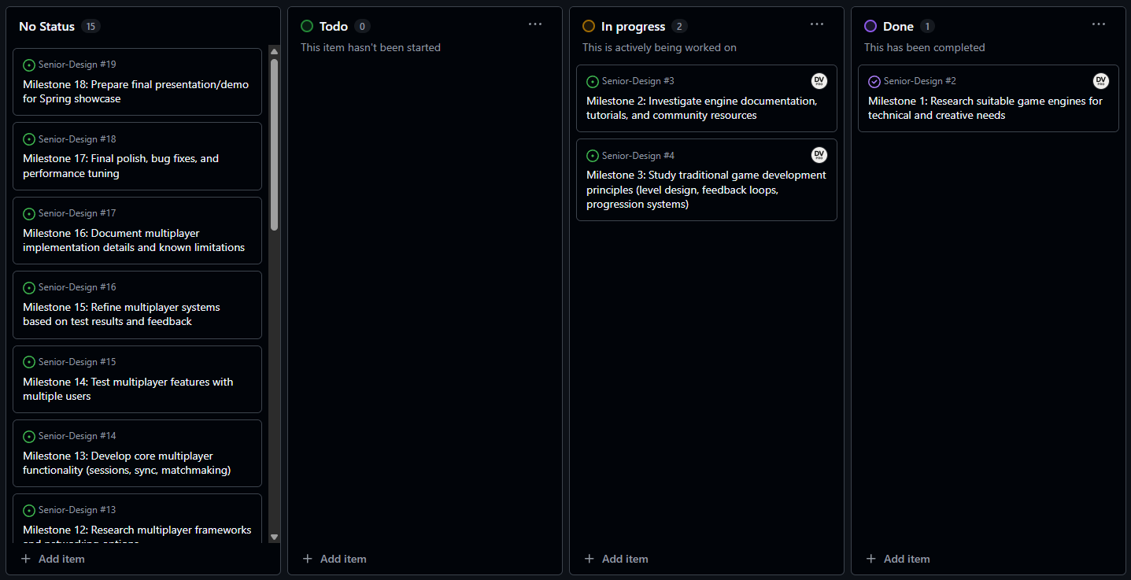
Current Project Progress
ByteForge

Slide 15
Expected Deliverable
Early Alpha Build
ByteForge

Slide 16
ByteForge
Thanks for Reading

Slide 17
THANKS FOR PLAYING
GUESS THE OBJECT
THANKS FOR PLAYING

